Slide 1
Identification of issues related to WRM in Bosnia and Herzegovina
Emina Hadžić
University of Sarajevo Faculty of Civil Engineering
Workshop on innovative practices in the EU water sector: barriers and opportunities / Wednesday, 8th May 2019
This project has been funded with support from the European Commission. This publication reflects the views only of the author, and the Commission cannot be held responsible for any use which may be made of the information contained therein.

Slide 2
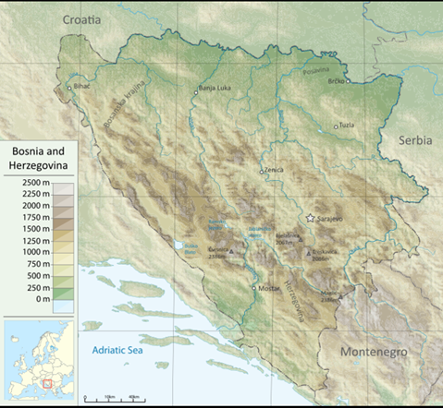
Bosnia and Herzegovina is located in South-East Europe at the Western Balkans peninsula. The total area of the country is 51.209,2 km2, of which 51.197 km2 is land, and 12,2 km2 is the area of the sea. The total border of Bosnia and Herzegovina with the neighboring countries is 1.538 km, of which the land border is 774 km long, 751 km in the river and 13 km inland.
1.1 Geography of Bosnia and Herzegovina
Of the total land area, 5% are lowlands, 24% hills, 42% mountains and 29% karst . Almost 80% of territory of BiH spreads between 200 m and 1500 m above the sea level
Fig. 1 Topographic map of Bosnia and Herzegovina
Strengthening of master curricula in water resources management
for the Western Balkans HEIs and stakeholders
www.swarm.ni.ac.rs

Slide 3
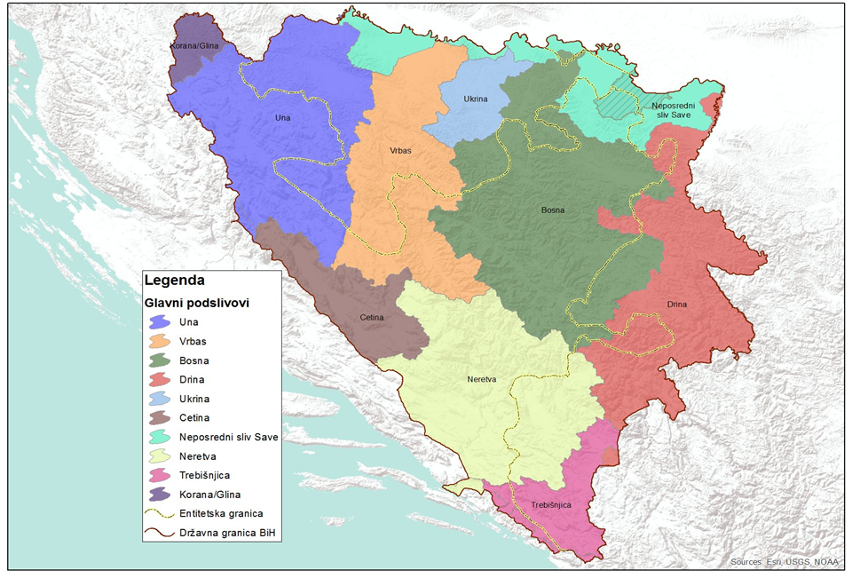
1.2 Hydrographic characteristics of Bosnia and Herzegovina
Bosnia and Herzegovina has significant water resources that represent one of the base economic potential.
Hydrographically, Bosnia and Herzegovina belongs to Black (75%) and Adriatic Sea (25%) basins.
According to the World Bank report [2003], the relative annual availability of water resources per capita rank Bosnia and Herzegovina in the countries of "average water availability" between 5.000-10.000 m3/capita.
Fig. 2 Major River Basins and the related sub-basins in BH
Annual precipitation amounts range from 800 mm in the north along the Sava River to 2000 mm in the central and southeastern mountainous regions of the country (period 1961-1990). Average annual precipitation in BiH is about 1,250 mm.
However, it is not evenly distributed, either spatially or temporally
www.swarm.ni.ac.rs

Slide 4
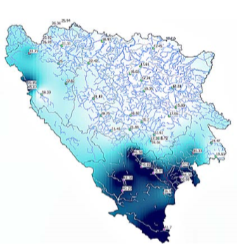
Based on date given in the Table 1. it could be concluded that ¾ area of Bosnia and Hezegovina discharge towards Black Sea has two times less average discharge (18 l/s/km2) compared to ¼ of the country area that belongs to Adriatic Sea, where the average discharge is 35 l/s/km2.
Also, around 88% of the population lives on the territory of the Black Sea Basin and the average discharge is about 0.18 l /s/capita, which is five times less than in the Adriatic Sea Basin, where the average discharge is about 0.84 l/s/capita.
Fig. 3 The average surface discharge in BiH (l/s/km2), according to the flows registered in the profiles of surface watercourses
Table 1 Specific discharges of average and minimum water flow in Bosnia and Herzegovina
Basin | Area (km²) | No. of inhabitants (1991.) | Average Discharge |  |  | Minimal Discharge
 |  |  | m³/s | l/s/km² | l/s/capita | m³/s | l/s/km² | l/s/capita
Black Sea | 38.719 | 4. 012.266 | 722 | 18 | 0,18 | 118 | 3 | 0,03
Adriatic Sea | 12.410 | 515.366 | 433 | 35 | 0,84 | 58 | 4,7 | 0,11
Bosnia and Herzegovina | 51.129 | 4.527.626 | 1.155 | 23 | 0,25 | 176 | 3,5 | 0,04
Strengthening of master curricula in water resources management
for the Western Balkans HEIs and stakeholders
www.swarm.ni.ac.rs

Slide 5
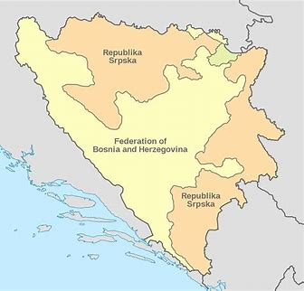
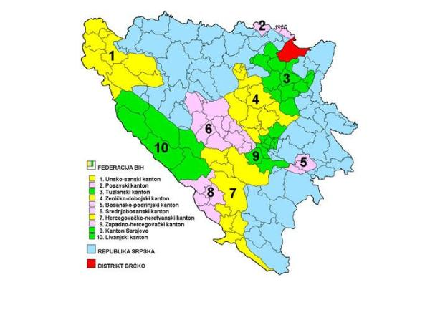
2 Policy, Strategic Planning and Legal Framework
Bosnia and Herzegovina is decentralized state with two entities (Federation of Bosnia and Herzegovina and Republic of Srpska) and Brcko District. FBiH consists of 10 cantons (each canton has its Government and Constitution).
There are 16 administrative cities, 71 municipalities in FBiH and 57 municipalities in RS as the local administrative units. Brcko District is formed in 2000. as a separate administrative unit administratively under direct sovereignty of Bosnia and Herzegovina.
Strengthening of master curricula in water resources management
for the Western Balkans HEIs and stakeholders
www.swarm.ni.ac.rs

Slide 6
According to the Constitution of Bosna and Herzegovina, and the FBiH, RS and Arbitration Decisions on the Brčko District, competencies in water management (development, water protection, water use, watercourse regulation and protection against harmful effects of water) are under the competence of entities (and cantons in the Federation of BiH) and the Brčko District, while BiH's foreign policy in the water sector is under the jurisdiction of BiH institutions.
Such a constitutional solution must be treated in two ways.
On the one hand, it gives a lot of rights, because responsibility in water management - as the most vital national resource - is entrusted to the entities, giving them the highest level of state-legal legitimacy and significance.
On the other hand, it is also a significant obligation, because it implies great responsibility to ensure that in very complex management conditions, as the entity boundaries do not match hydrographic units, they find the best forms of management coordination, which will ensure optimum water management in conditions of very complex structure in the basins
Strengthening of master curricula in water resources management
for the Western Balkans HEIs and stakeholders
www.swarm.ni.ac.rs

Slide 7
COMPETENCE FOR WATER MANAGEMENT IN BH
State level:
Ministry for Foreign Trade and Economic Relations,
Entities level:
  Federation of BiH
    Ministry for Agriculture, Water Management and Forestry of Federation BH,
    Sava River Watershed Agency Sarajevo,
    Adriatic Sea Watershed Agency Mostar,
    Cantonal ministries responsible for water management,
  Republic of Srpska
    Ministry for Agriculture, Water Management and Forestry of Republic Srpska
    Water Agency for Sava River District Bijeljina
    Water Agency for Trebišnjica River District Trebinje
  Brčko District
    Department for Agriculture, Forestry and water management
Local level:
    Municipalities (more than 140) responsible for water supply and sanitation services (through public companies)
Strengthening of master curricula in water resources management
for the Western Balkans HEIs and stakeholders
www.swarm.ni.ac.rs

Slide 8
3 Issues related to WRM in Bosnia and Herzegovina
There is mainly no state-level law on water resources policy. Numerous recommendations were made to the country in the past two decades to adopt such a law. Since 2011 Bosnia and Herzegovina has made some efforts to transpose the EU environmental acquis into the national legislation; however, the country is still at an early stage in these efforts.
Bosnia and Herzegovina does not have a national sustainable development strategy or other comprehensive development strategy.
The draft development strategy and draft social inclusion strategy were prepared for the period 2008–2013 but were never adopted.
Also, there is no water Management strategy for BiH, because the entities are legaly responsible for water management.
Strengthening of master curricula in water resources management
for the Western Balkans HEIs and stakeholders
www.swarm.ni.ac.rs

Slide 9
Conclusions
In Bosnia and Herzegovina, since the Dayton Agreement, there is no clear organized structure for water management at the state level. This is certainly a major challenge since the FBiH, RS and BD have their own separate constitutions and governments, separate legislation, including water management and environmental legislation. It is obvious that differences in entity water management structures make it impossible to effectively manage water resources.
In Bosnia and Herzegovina, itself, given the fact that six of the seven rivers flow through both entities and pass through at least two cantons, there is a clear need for co-ordination and co-operation on the inter-cantonal and inter-entity basis.
Another significant obstacle for the water sector is the lack of a national-level organization, responsible for overall water management and coordination. This leads to numerous problems and obstacles to effective international cooperation in the field of water resources.
Strengthening of master curricula in water resources management
for the Western Balkans HEIs and stakeholders
www.swarm.ni.ac.rs

Slide 10
Generally, it could be said that Bosnia and Herzegovina still faces the problems with inadequate: urban and industrial water supply; infrastructure (water and sewage-treatment plants and outdated water pipelines and sewage systems); protection of the drinking water resources; collection, treatment and disposal of urban and industrial wastewater; flood risk control; protection of the water ecosystems; capacities and expertise in the institutions and utility companies; etc.
Beside those problems, very significant issue is development of the institutional framework for water management sector. These problems exist due to the lack of Integrated water resources management strategy and institutional arrangement at the state level, insufficient financial support and incompatible legislation.
Strengthening of master curricula in water resources management
for the Western Balkans HEIs and stakeholders
www.swarm.ni.ac.rs

Slide 11
To response to those challenges BiH authorities should be focused on the: (i) Strengthening of the institutional framework, preparation of strategic, planning and legal documents at the state level; (ii) Improving intersectoral cooperation and coordination at all level of governance; (iii) Harmonization of water legislation and planning documents with EU policy and legislation; (iv) Improving infrastructure for water management; (v) Develop adequate economical and financial instruments in water resources management.
The fact is that for the fulfillment of the set goals, take a long time to respond to the challenges, but well water resource management should be a priority in the development plans of each country, as well as Bosnia and Herzegovina.
Strengthening of master curricula in water resources management
for the Western Balkans HEIs and stakeholders
www.swarm.ni.ac.rs

Slide 12
Thank you ☺
Strengthening of master curricula in water resources management
for the Western Balkans HEIs and stakeholders
www.swarm.ni.ac.rs

